Slide 1
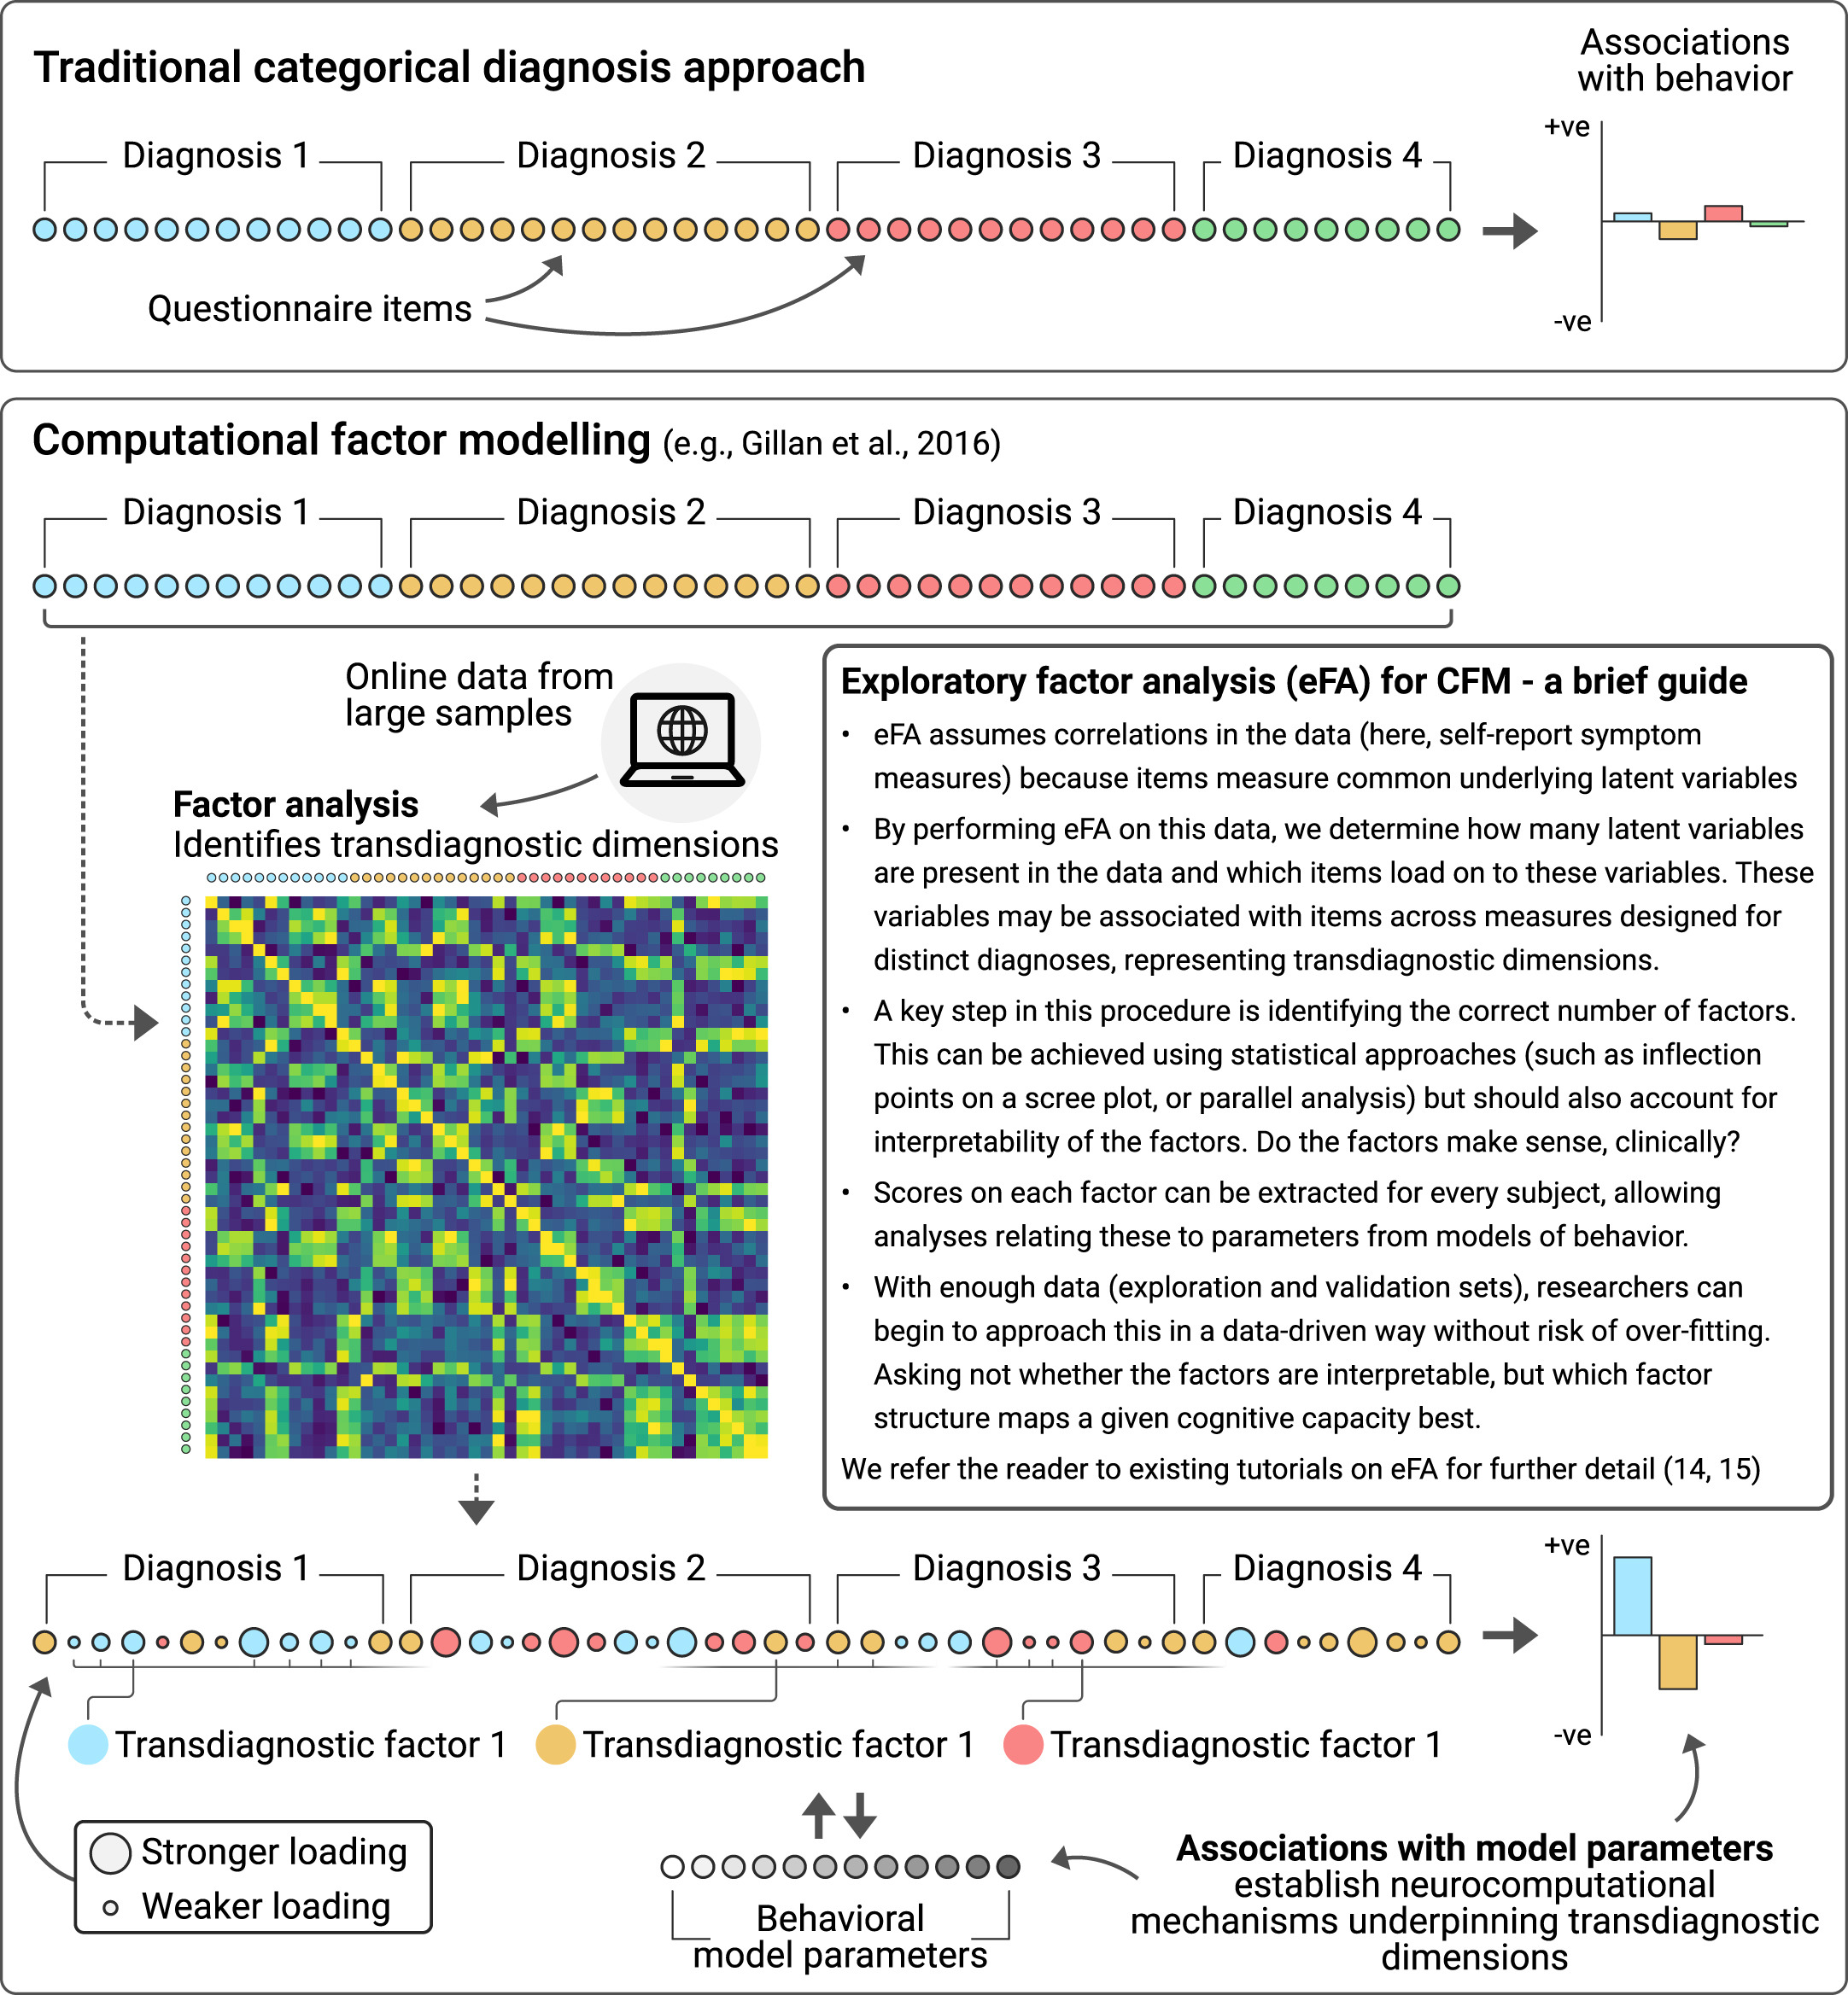
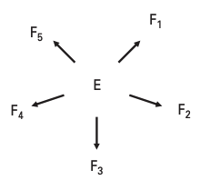
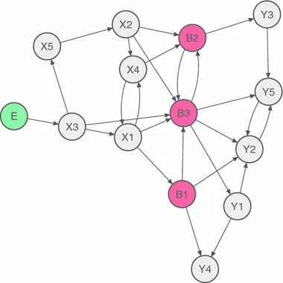




The evolving concept of
diagnostic classification in psychiatry
neuromethods, 25 January 2024
Aamir Sohail & Lei Zhang
Notes:
Mention the importance of having a historical viewpoint of psychiatric disorders, as if we are attempting to understand them in a computational psychiatry framework, it helps to know they are defined, and how this definition came to be.

Slide 2
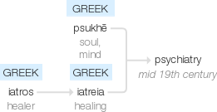
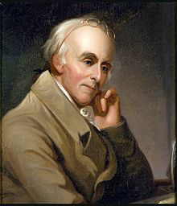
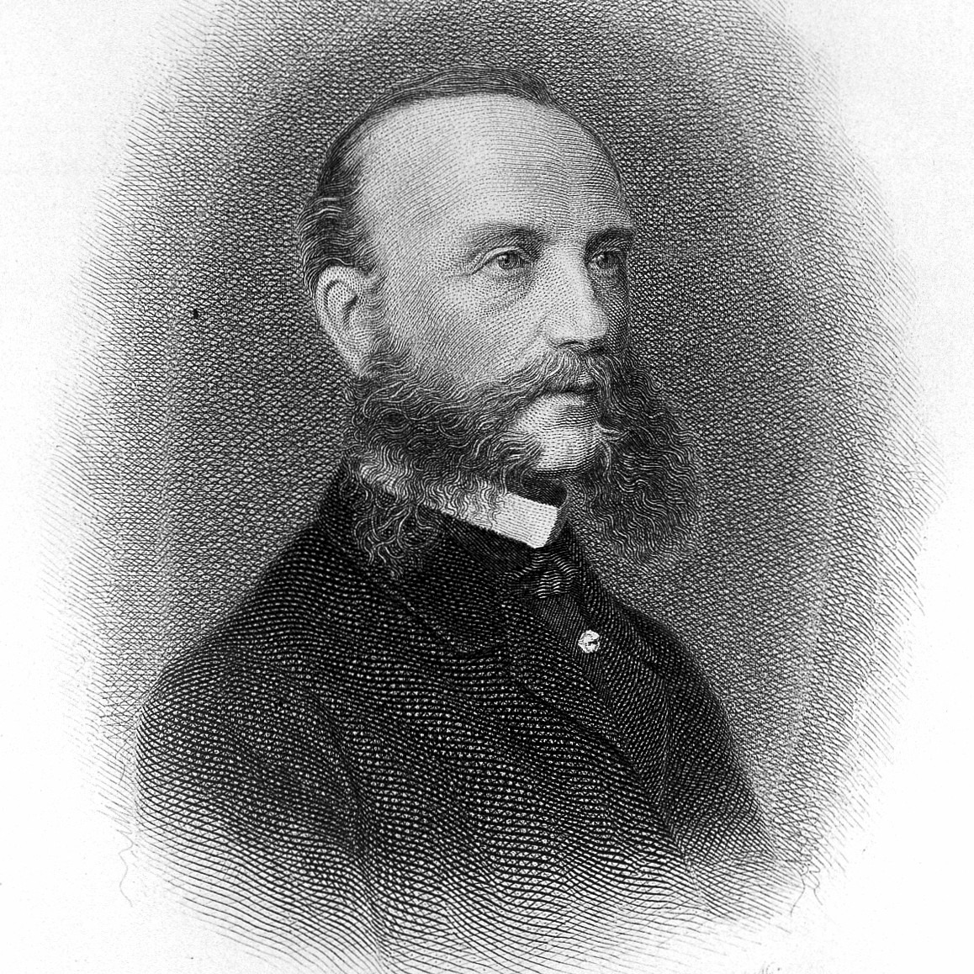
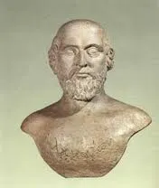
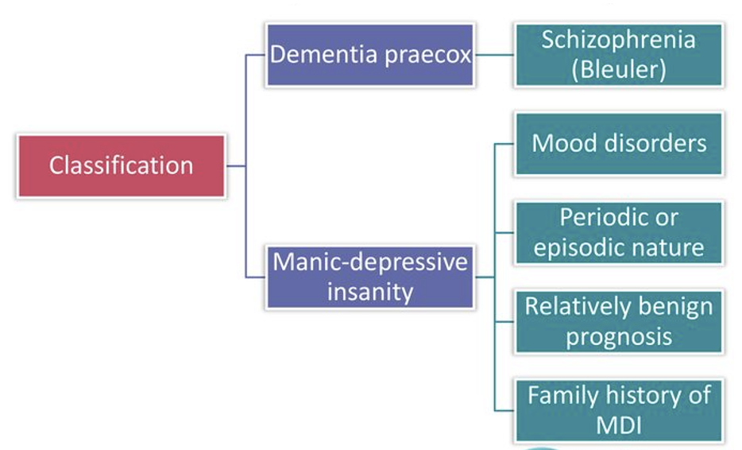
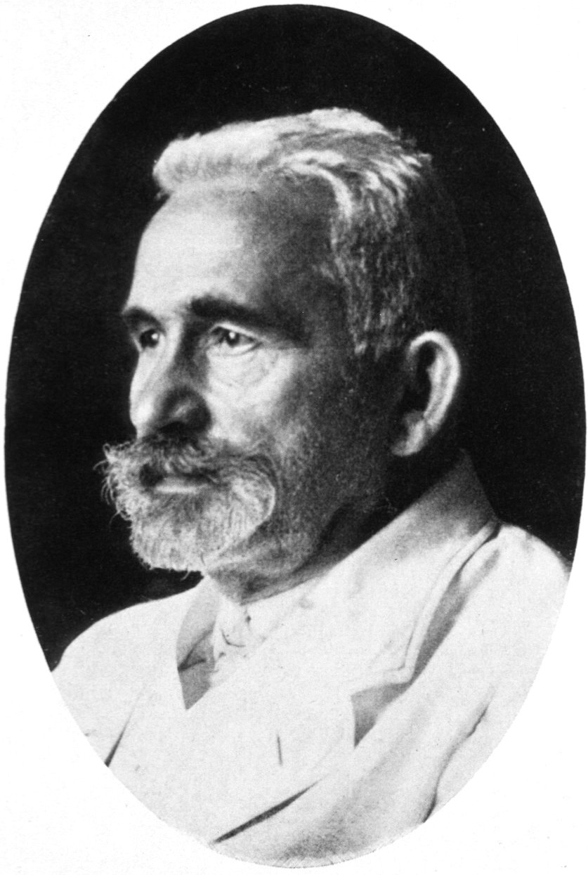
A (very) brief history of psychiatry
Benjamin Rush
(1745-1813)
Wilhelm Griesinger
(1817-1868)
Alcmaeon of Croton
(6th Century B.C.)
Emil Kraepelin
(1856-1926)
Notes:
Alcmaeon was the first to identify the brain as being the primary organ responsible for human behaviour, and associated the cause of epilepsy to it, rather than being a curse from the gods. He went on to influence further Greek thinkers the most famous being Hippocrates.
In the middle ages, mental illness was viewed primarily with stigma, with insane asylums condemning those thought to be mentally problematic. Benjamin Rush was the first to suggest actually listening to patients, introducing the conversationalist approach.
Griesinger is credited with the advent of a psychopathology, linking changes in physiology with mental health conditions, and identifying that multiple symptoms may in fact be caused by the evolution of a single mental illness.
But is was Kraepelin who ultimately set into the stone the idea of a ‘diagnostic taxonomy’ of mental health disorders, relating to his work on dementia and insanity doing so in the 1880s.

Slide 3
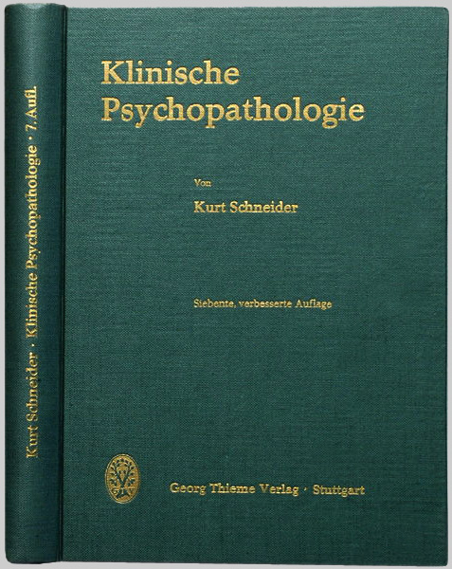
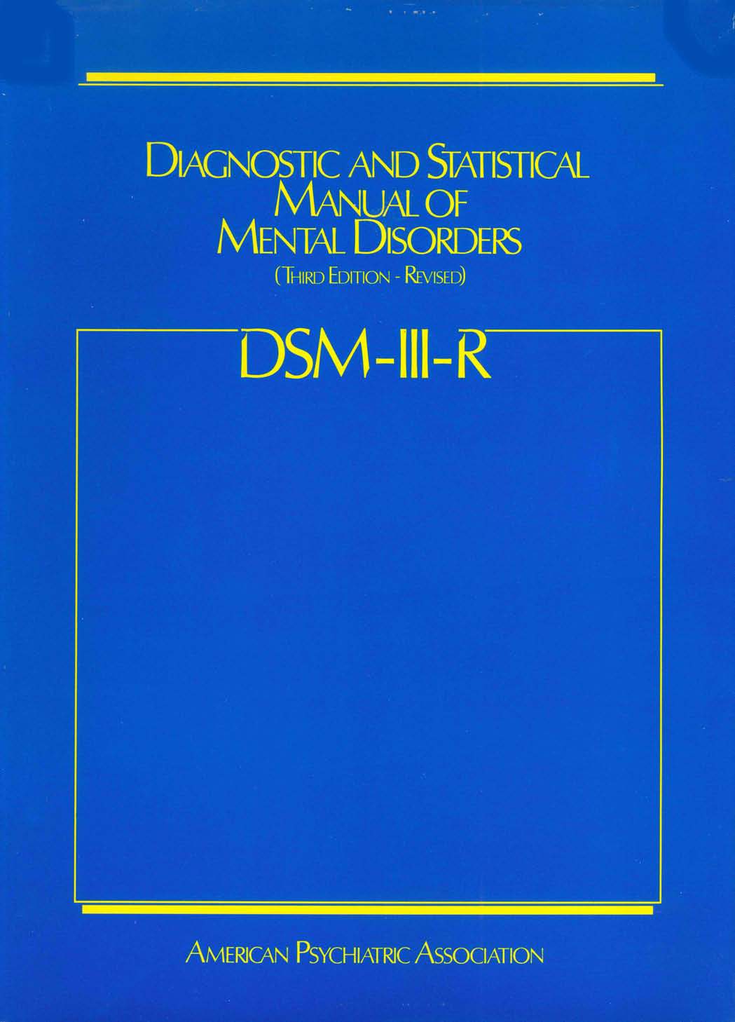

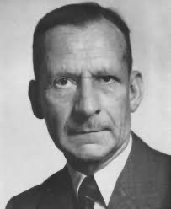

Diagnostic criteria and classification
A priori beliefs
Klinische Psychopathologie
(1950)
DSM-III
(1980)
Kendler, 2009
Essentialist view of psychiatric disorders
Kurt Schneider
Robert Spitzer
Kendler et al., 2010; Adriaens & De Block, 2013
Notes:
I mention the history not just for a historical tidbit, but the initial diagnostic criterion developed in the earlier part of the 20th century ended up influencing the current diagnostic manuals which we use today. For example, the Schneideran First Rank symptoms for schizophrenia influences Spitzer’s initial classification in the DSM-III.
This relates to a similar criticism stemming from the presence of a priori beliefs from the classifiers about the things they are classifying, and the nature and goals of those classifications. The time also reflected the now-challenged essentialist views, that is mental health disorders are caused by some shared essential criterion.

Slide 4
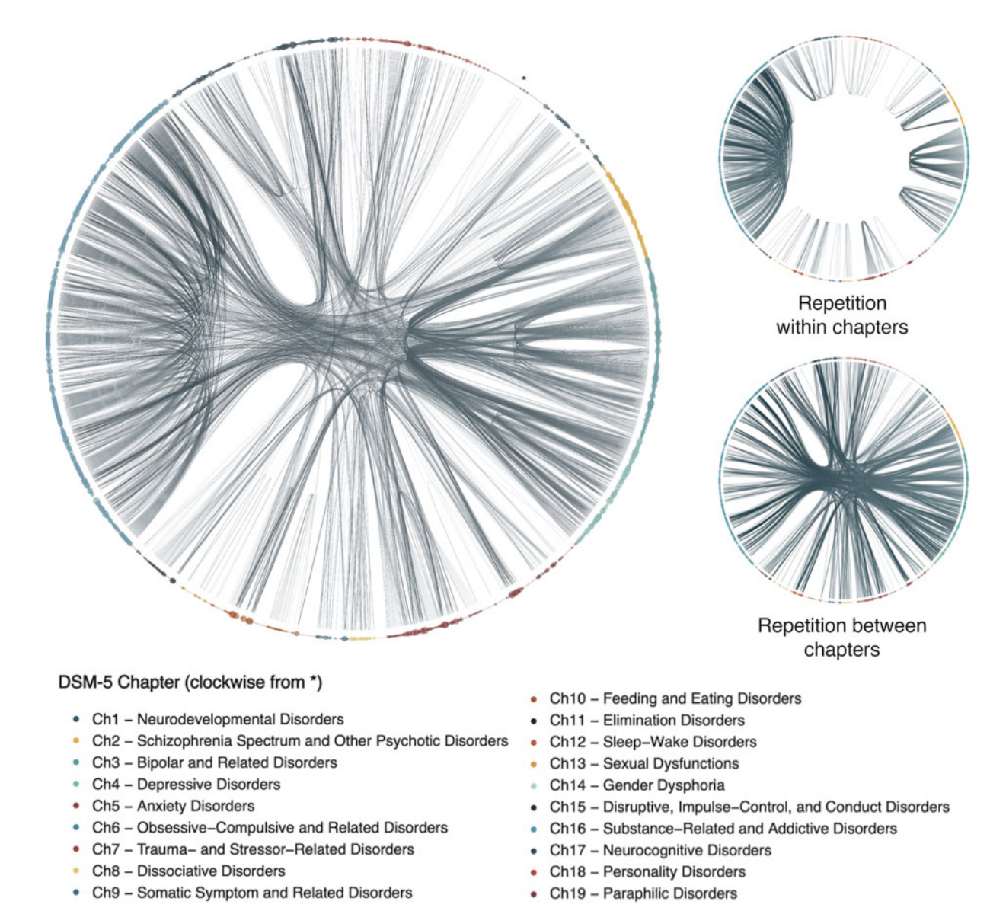
628 distinct symptoms:
397 symptoms (63.2%) were unique to
a single diagnosis, whereas 231 symptoms (36.8%) repeated
Forbes et al., 2023
Notes:
And you can see the influences of this essentialist view when looking at symptom repetition across the DSM.
This repetition undermines what we can learn from studying individual diagnostic constructs because it can obscure both disorder- and symptom-specific signals.

Slide 5
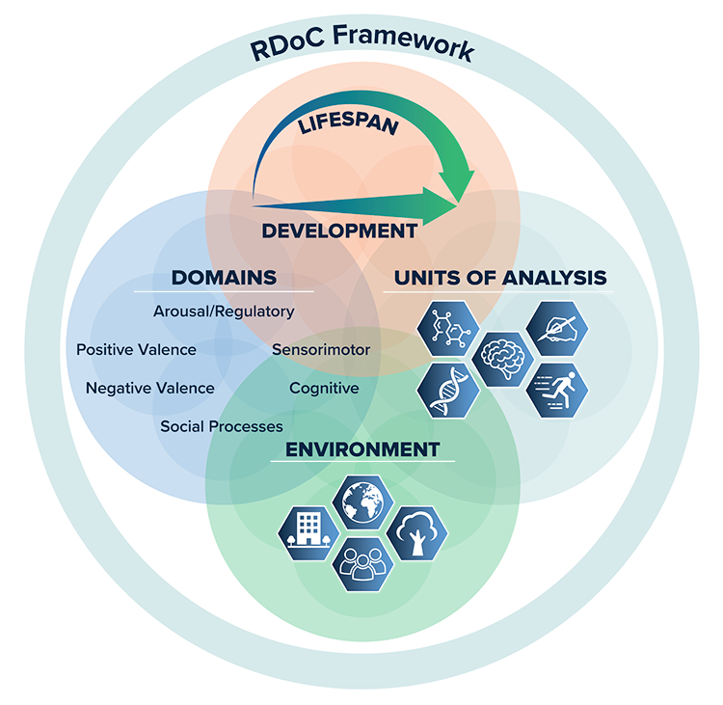
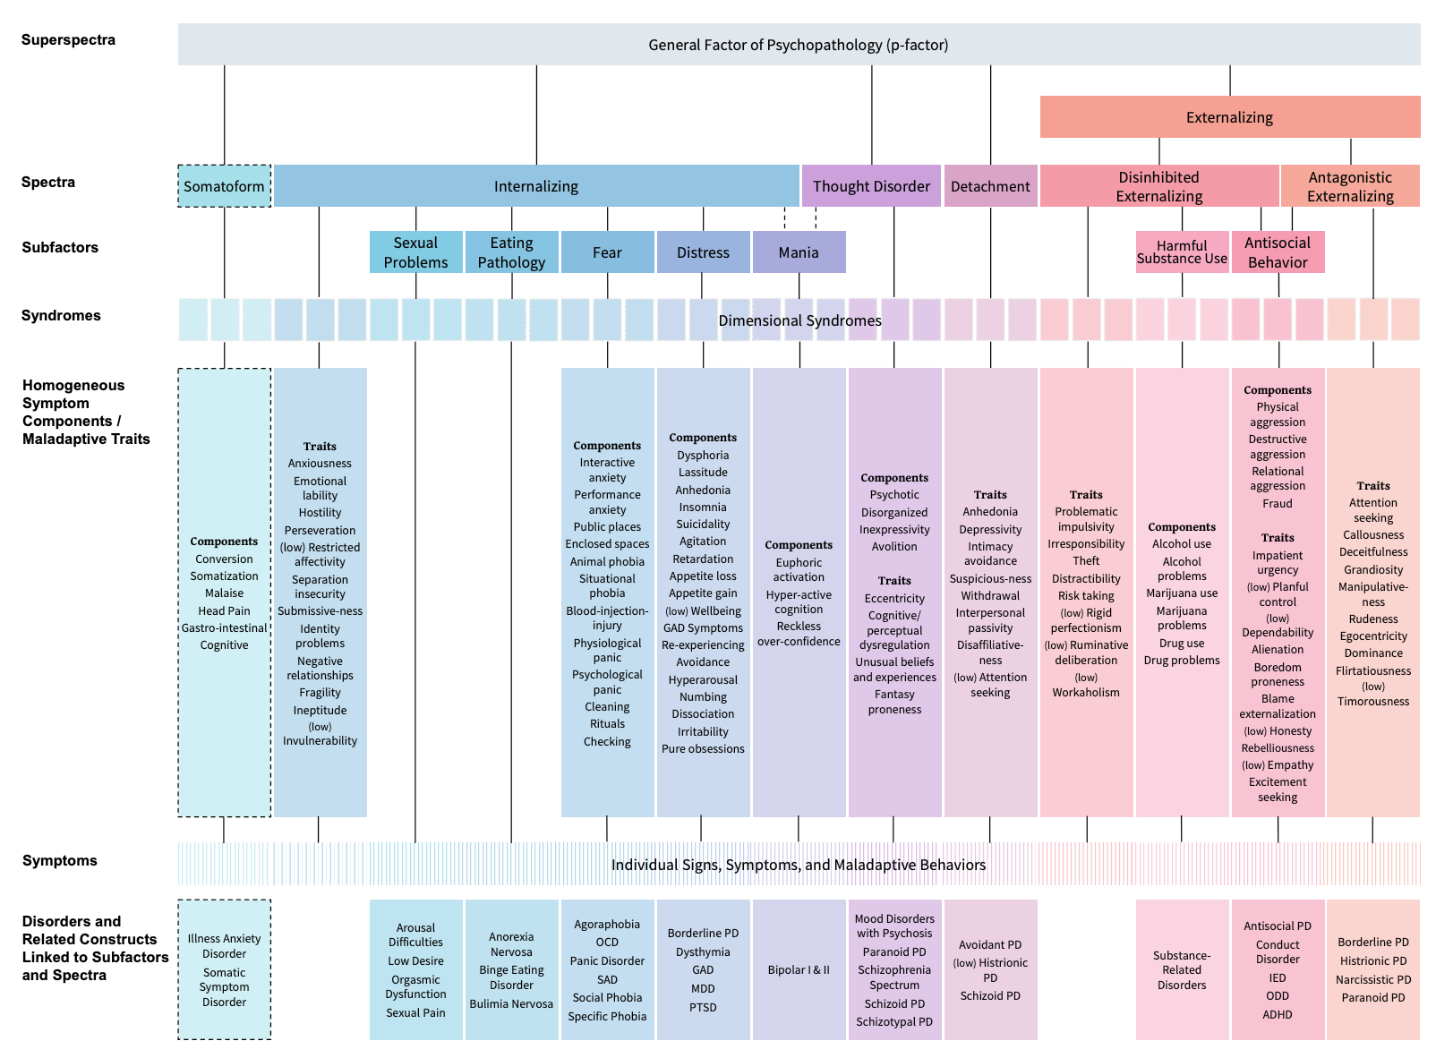
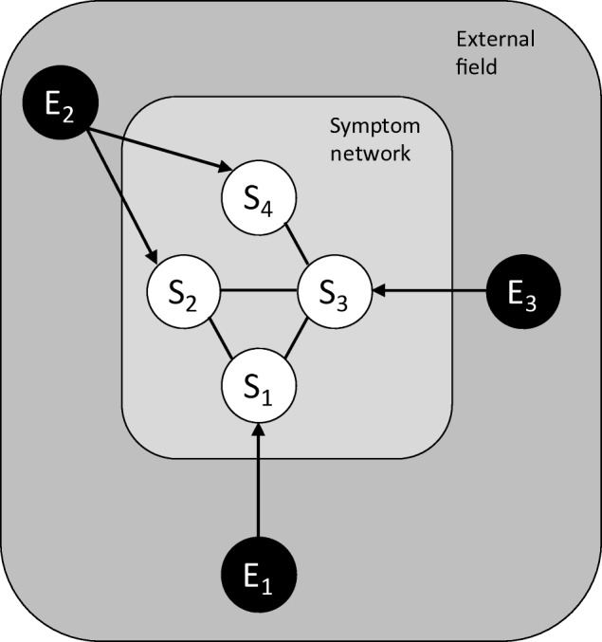
Alternative approaches
Shifting away from the categorical to a complex view in psychiatry
RDoC Framework
Insel et al., 2010
HiTOP Framework
Kotov et al,. 2022
Network theory
'a hierarchical model of data-driven
dimensions of psychopathology’.
Borsboom, 2017
Notes:
Recently, psychiatry has began to shift away from a categorical view on mental health, in response to well-documented issues with diagnostic frameworks in terms of comorbidity, reliability and heterogeneity.
There are numerous promising alternatives such as Research Domain Criteria and Network Theory of Mental Disorders. But most relevant to today’s talk is the HiTOP, or Hierarchical Taxonomy of Psychopathology, which is a hierarchical model.

Slide 6
Rief et al., 2023
Notes:
In this hierarchical model, dimensions are based on patterns of co-occurrence or covariation among symptoms and disorders, and the hierarchy arranges these dimensions from individual signs and symptoms at the bottom all the way up to very broad dimensions at the top.
In this framework, diagnoses are not “present” or “absent”; rather individuals’ symptom profiles indicate severity to guide intervention at the level of components, syndromes, and/or spectra.

Slide 7
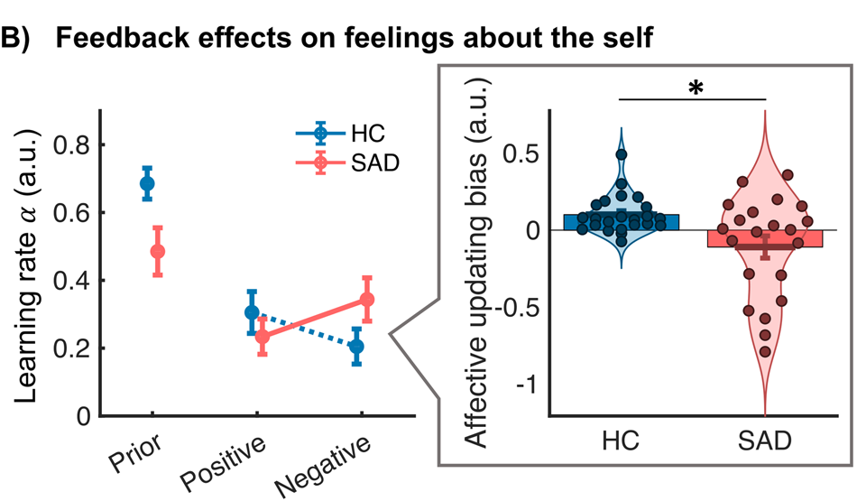
Measuring computational influences on behaviour
Numerous mental health conditions demonstrate changes in social information processing (e.g., social anxiety)
So, we should just correlate LSAS scores with features of the computational model?
Wise, Robinson and Gillan, 2023
Koban et al., 2017, 2023
Mental health disorders (including social anxiety) are heterogeneous in nature
Binelli et al., 2015; Reiter et al., 2021
Traditional categorical scores often do not represent the underlying cognitive processes nor map on to computational parameters
Notes:
A common feature of many mental health conditions including social anxiety is that they demonstrate changes in social information processing. So, in order to find out the relationship between the condition and the parameter of interest, we should just correlate the two together?
Well, this is what is conventionally done using a traditional categorical diagnosis approach, where scores for individual questionnaires are correlated with measures of behaviour. However, there are problems with this approach. Firstly…..
In the same way that categorical diagnoses do not capture individual variance in symptomatology, so too do traditional categorical scores not represent the underlying cognitive processes nor map onto computational parameters.
Therefore, a new approach aims to determine transdiagnostic factors and then associate these with model parameters, allowing for a more accurate translation between the computational model and the underlying psychopathology.

Slide 8









Computational factor modeling
“CFM aims to identify transdiagnostic symptom dimensions that are associated with precise neurocomputational mechanisms.”
“Unsupervised dimensionality reduction like exploratory factor analysis or PCA are used to identify crosscutting, data-driven latent symptom dimensions (e.g., compulsivity and intrusive thought) in large unselected samples, typically using data gathered online.”
Wise, Robinson and Gillan, 2023
Small, patient-specific sample with single diagnostic measure
Large, population-based sample with multiple diagnostic measures
(Parts adapted from Lombardo et al., 2019)
Notes:
This approach is called computational factor modeling, which aims to …
This is not to say that the traditional approach is invalid, but it is a useful approach for studies implementing a larger sample size, recruiting from a general population sample.

Slide 9
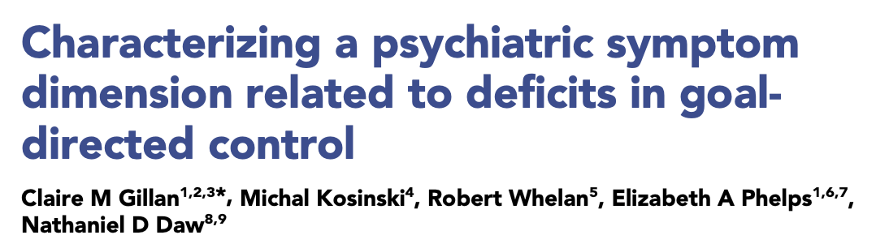
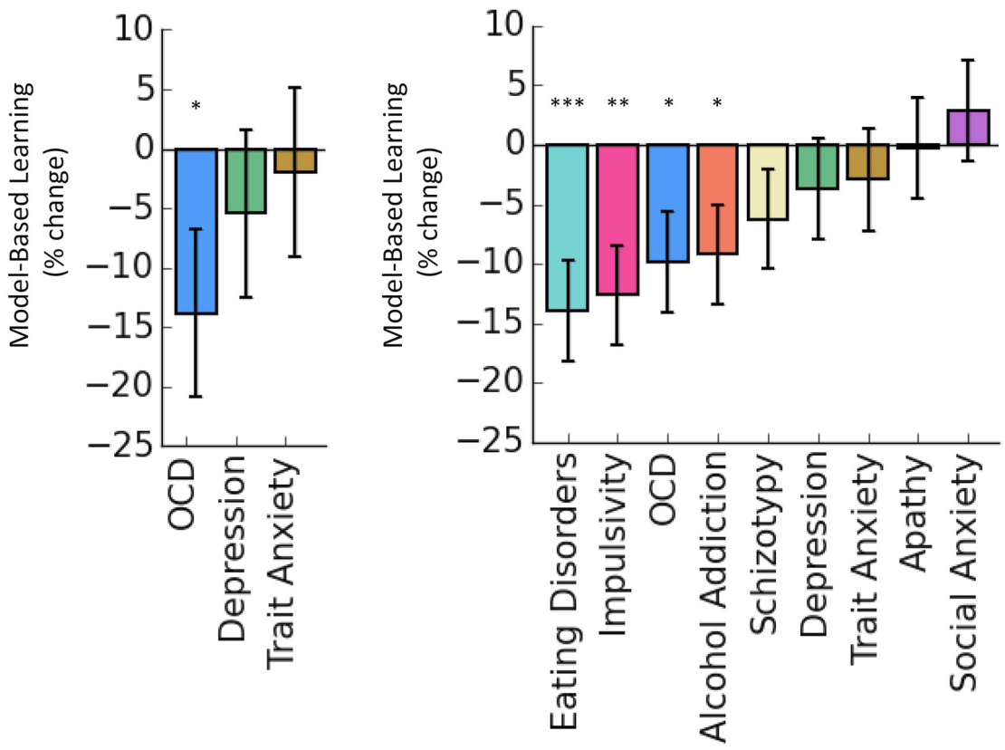
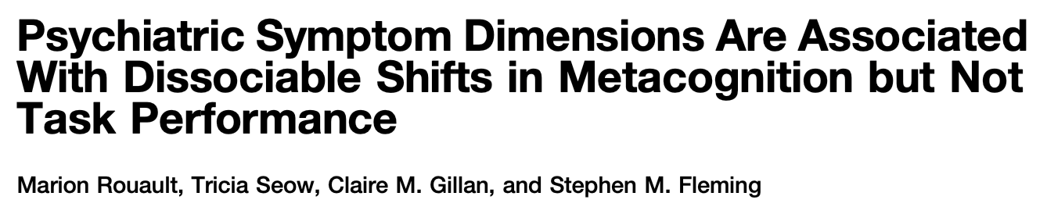
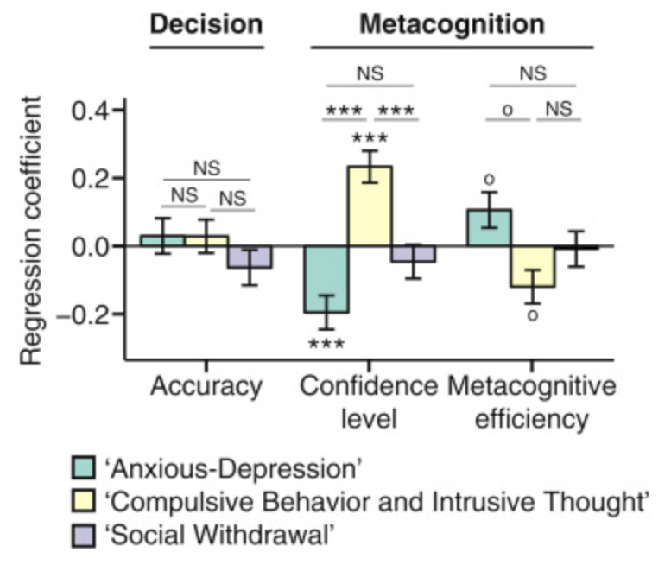
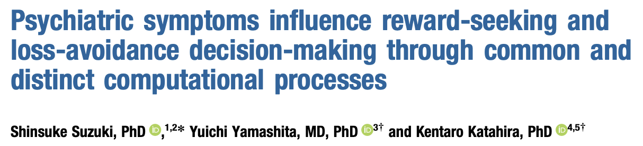
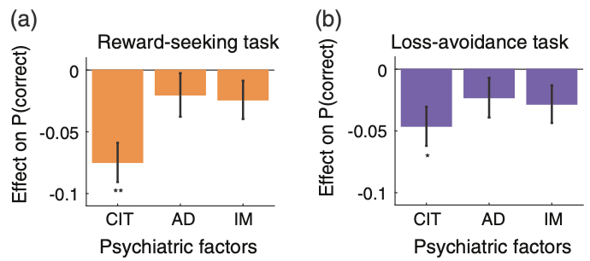

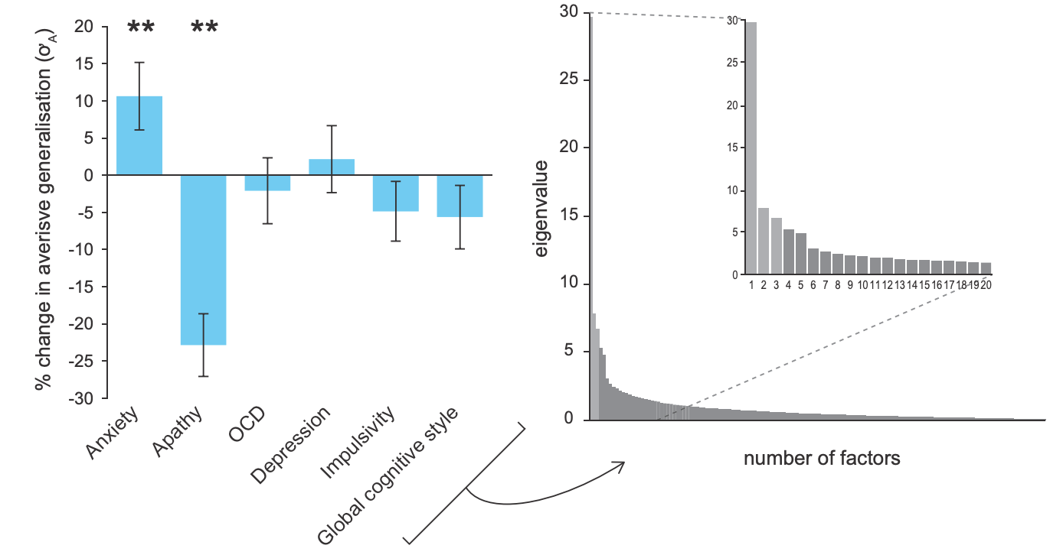
Computational factor modeling - examples
Model-based planning
Metacognition
Reward processing
Uncertainty

Slide 10
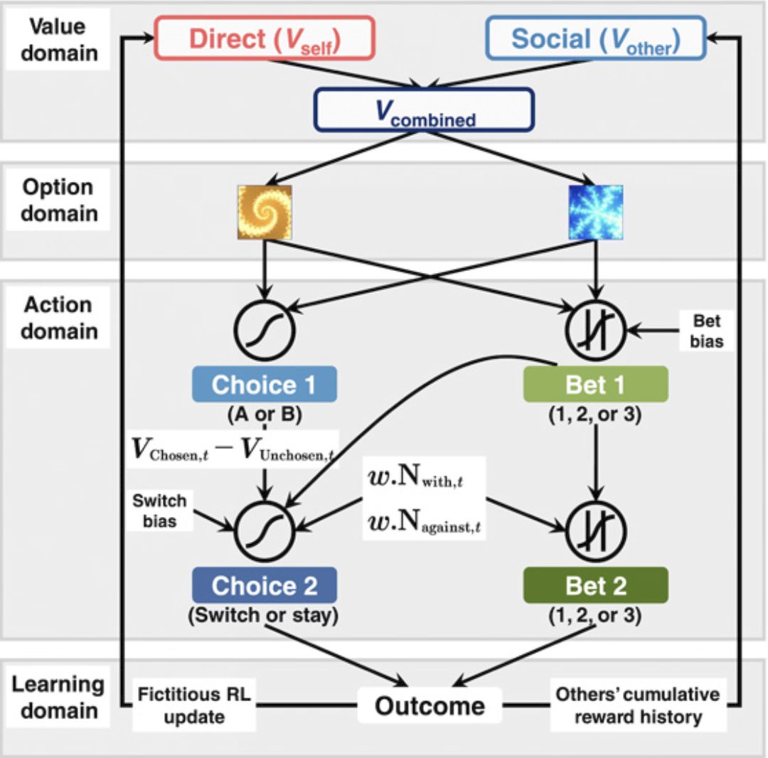
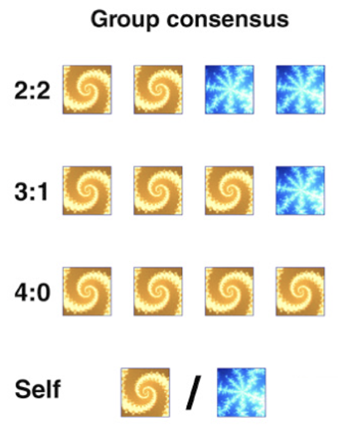
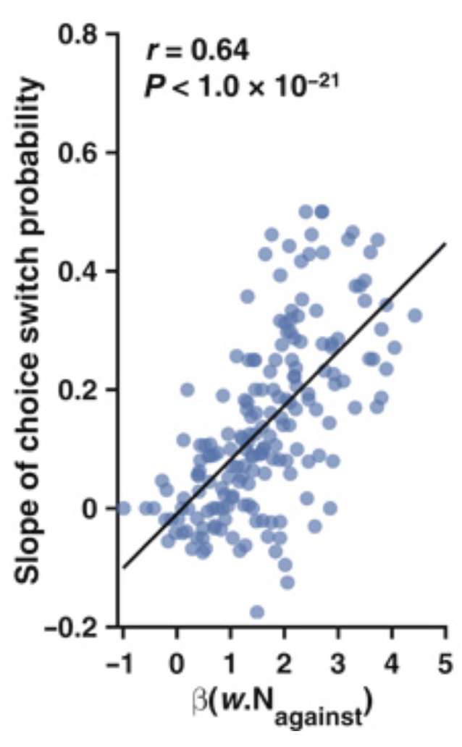
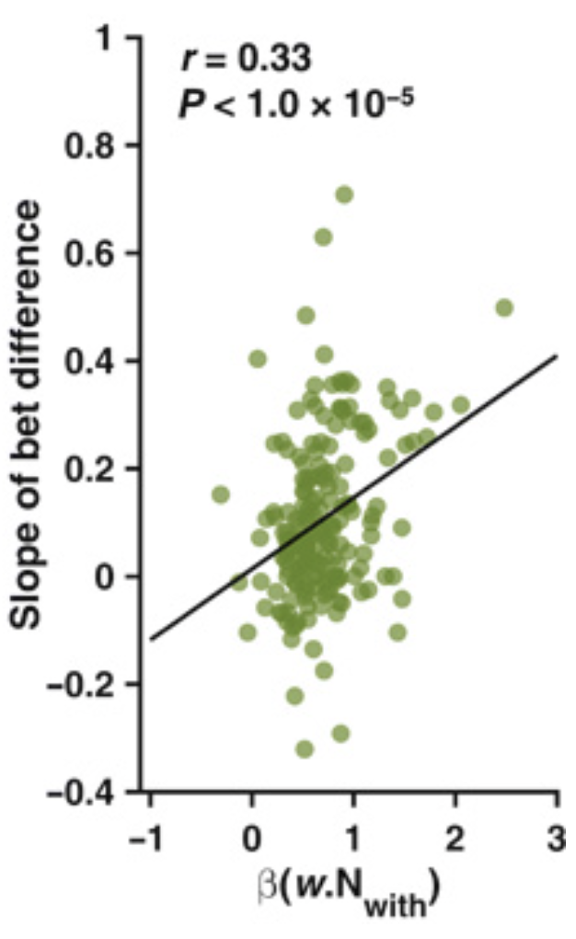


What do we (computationally) know so far?
Participants’ initial choice were accounted for by value signals updated from direct learning and social learning
Choice adjustments were ascribed to initial valuation and preference-weighted instantaneous social information
Value signals computed from direct learning and social learning are jointly used to guide future decisions
Zhang & Gläscher, 2020

Slide 11
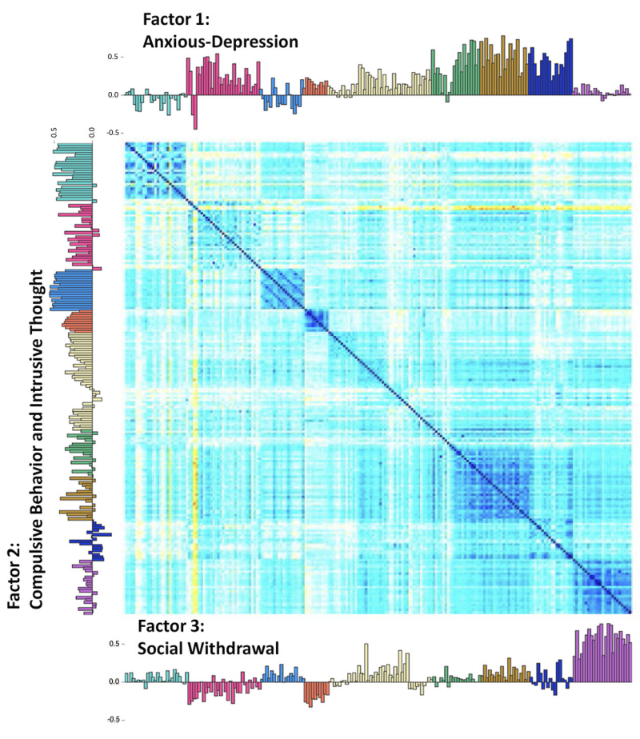
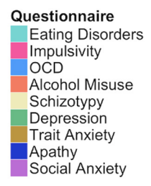
Hypotheses (specific to social anxiety)
Value signals computed from social learning are used significantly less to guide future decisions
This reflects existing research highlighting both a social learning and a ‘self-referencing bias’ in social anxiety
Gillan et al., 2014
Koban et al., 2017, 2023; Castagna et al., 2023
This should load onto the factor of Social Withdrawal, reflecting more accurately, the underlying symptomatology associated with social anxiety

Slide 12
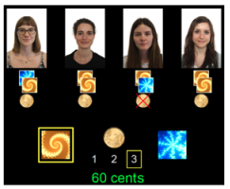
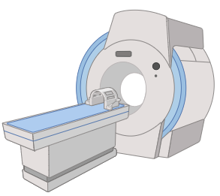




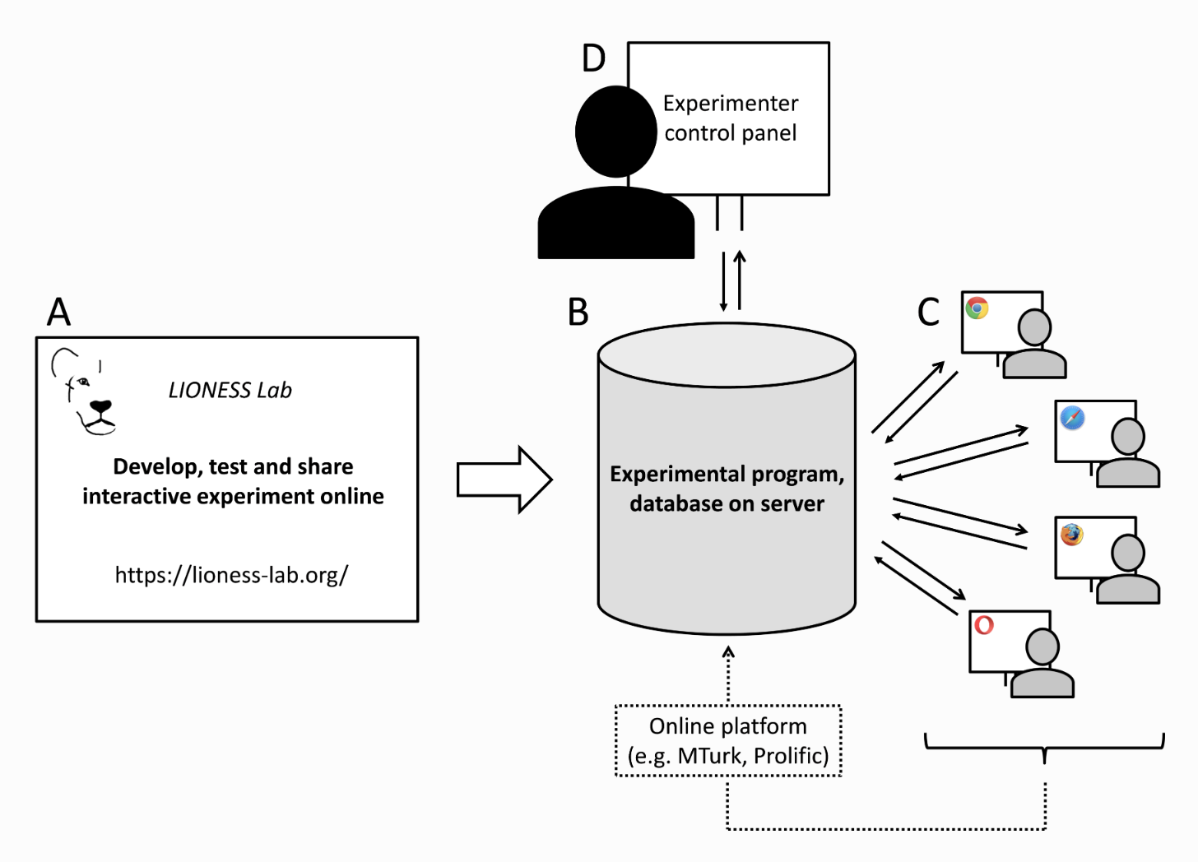
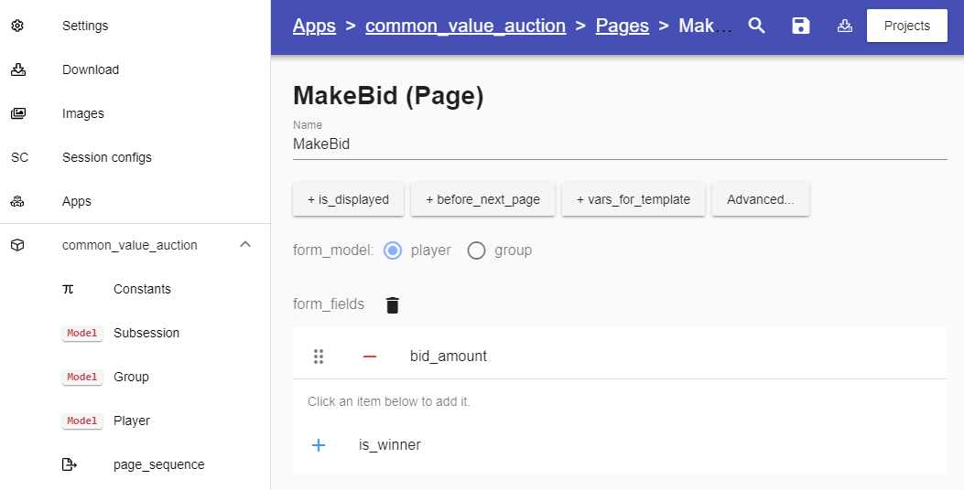
Implementing the task online
Live Interactive ONline Experimental Server Software (LIONESS)
Giamattei et al., 2022

